Slide 1
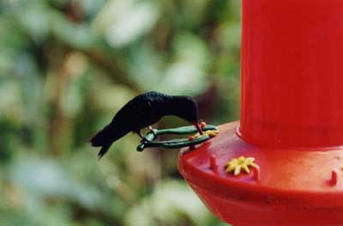
Simple Graphics Guide

Slide 2
Key Points
Pixels and pixel depth
Resolution
File types
File sizes
Compression of graphics files

Slide 3
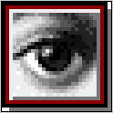
Pixels
The computer stores and displays pixels, or picture elements.
A pixel is the smallest addressable part of the computer screen.
A pixel is stored as a binary code representing a colour.
The code for a pixel can have between
1 and 32 bits of binary code.

Slide 4
Pixels Example
Here is the Photoshop logo at normal size.
Here it is enlarged 400% so that you can see the individual pixels.

Slide 5
Pixel Depth
Pixel Depth describes the number of bits used to store each pixel.
The greater the pixel depth, the more colours a pixel can have.
Colour graphics vary in realism depending on resolution and pixel depth.
The greater the pixel depth, the bigger the file.

Slide 6

Examples of Pixel Depth
Monochrome
Monochrome graphics have one-bit pixel depth. (pure black or pure white)

Slide 7
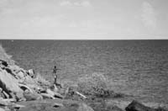
Examples of Pixel Depth
Gray-Scale
Gray-Scale graphics have more bit-depth
(No colours besides black, white and grey)

Slide 8

Examples of Pixel Depth
8 Bit Colour
8 bits per pixel provides 256 colour choices
(Typical of the web - that’s why web graphics need some skilful preparation)

Slide 9
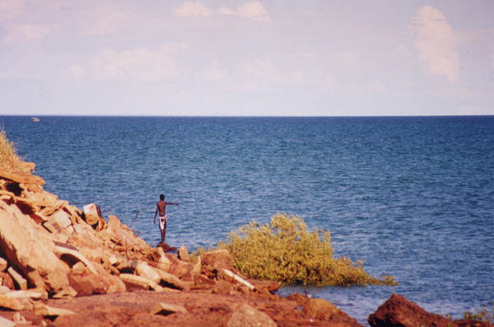
Examples of Pixel Depth
24 or 32 bits per pixel provides thousands or millions of colour choices. (Typical of graphics and games software)

Slide 10
Resolution
Resolution refers to the density of dots on the screen or printed image and directly affects quality
The higher the resolution, the less jagged the image.
Resolution is measured in DPI (Dots per Inch)
(The printing industry is largely unmetricated and still uses inches because printing measures such as the Point (1 72nd of an inch) do not easily convert to metric units.)
The higher the resolution, the better the potential output.

Slide 11
Typical Resolutions
Screens generally operate at around 72-100 dpi
Printed images range from 300 to 2400 dpi
Resolution affects the file size of an image.
The higher the resolution, the bigger the file.
The visible resolution is limited to the maximum possible on the output device (screen or printer).
No matter how high the resolution of a photograph, it will show at the resolution of your screen or printer.

Slide 12
File Types
There are many kinds of graphics file formats and this is a specialised area and a bit complicated.
Examples : bmp GIF JPEG TIFF PICT Raw
For most applications involving photographic images, use the JPEG file format (Joint Photographic Experts Group)
For graphics or paint type files use GIFs
(Graphical Interchange Format)

Slide 13
Example (without compression)
A standard postcard is 6in by 4in
in 8 bit colour (256 colours), the following is true
At a resolution of 100 dpi the image is 600 by 400 dots so comprises 240,000 pixels. Each pixel is 1 byte so that’s
  240000 bytes (240KB)
At a resolution of 300 dpi it becomes 1800 by 1200 dots
  2160KB (2MB) That means it is now 9 times as big!
At a resolution of 600 dpi it becomes 3600 by 2400 dots
  8640KB (8MB) - Now 36 times as big!
And on screen you can’t see any difference!
Note - for 32 bit colour (millions of colours) the file sizes are 4 times bigger again!

Slide 14
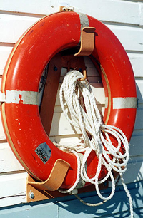
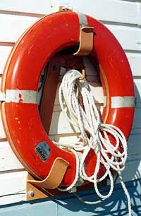
Example of JPEG compression
JPEG Quality 10 File Size 100K JPEG Quality 1 File Size 32KB
Not much loss even at the greatest compression

